Slide 1
ΑΓΡΟΤΙΚΗ ΠΟΛΙΤΙΚΗ
2015-2016
Οικονομική Ανάλυση

Slide 2
CV, EV, & CS
CV and EV μετρούνται σε Hicksian (compensated) demand curves
CS μετράται σε Marshallian demand curve
CS αποτελεί προσέγγιση της μεταβολής της ευημερίας

Slide 3
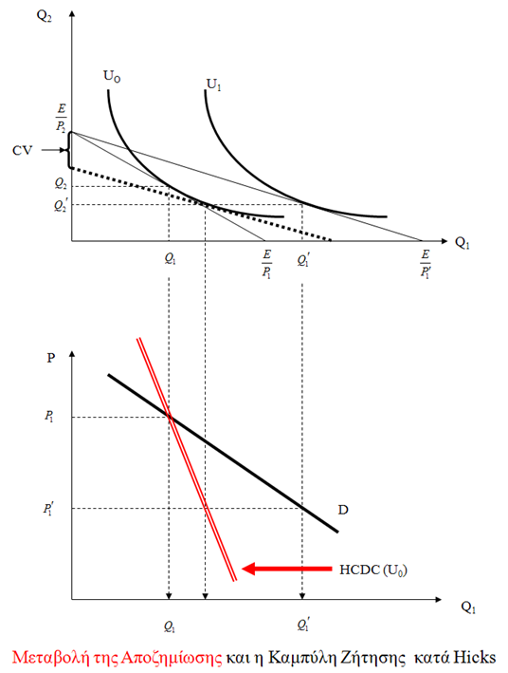
Marshallian and Hicksian Demand Curves

Slide 4
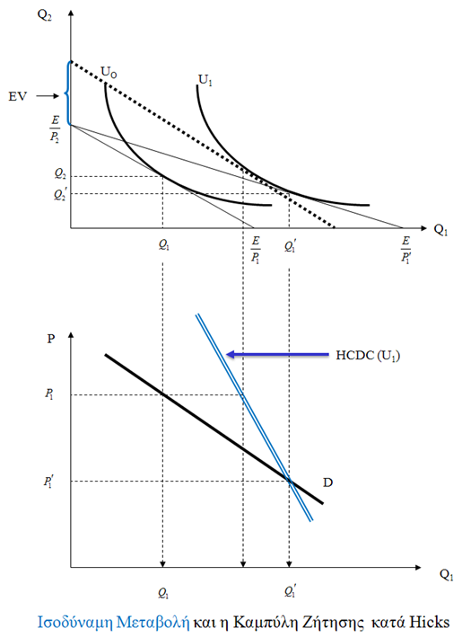

Slide 5
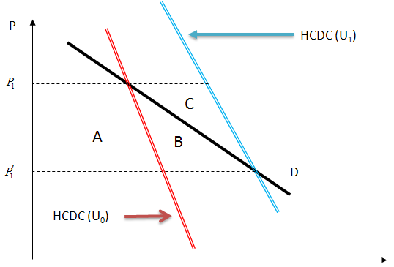

Slide 6
Comparison of CS, EV CV
Empirically, we are able to estimate CS, but not EV or CV.
How close an approximation is CS to EV or CV?
Depends on magnitude of the income effect
Differences are small for small price changes
Differences are small if (Marshallian) demand curve is inelastic

