Slide 1
USDA FoodData Central:
Platform and
Integrated datasets description

Slide 2
USDA FoodData Central
FoodData Central is the USDA-based food-composition information web center.
It is an integrated data system that presently provides 5 distinct types of data in one place.
Each data type has a unique purpose.
The five data types are:
SR Legacy: National Nutrient Database for Standard Reference
GBFPD: Global Branded Food Products Database
FF: Foundation Foods Database
FNDDS: Food and Nutritional Database for Dietary Studies
EF: Experimental Foods Database

Slide 3
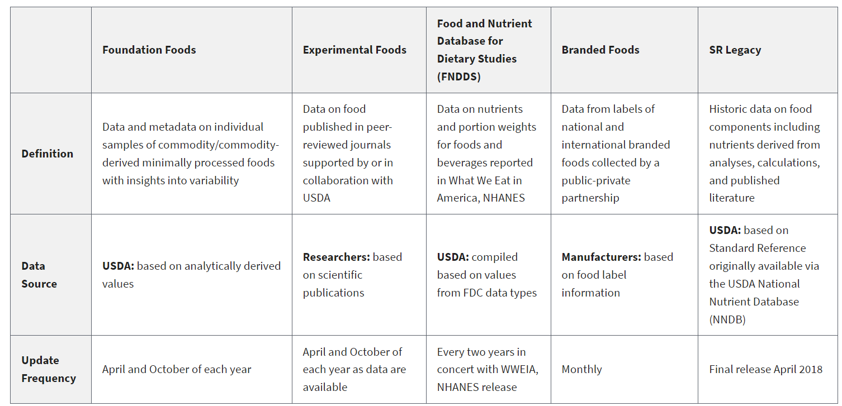

Slide 4
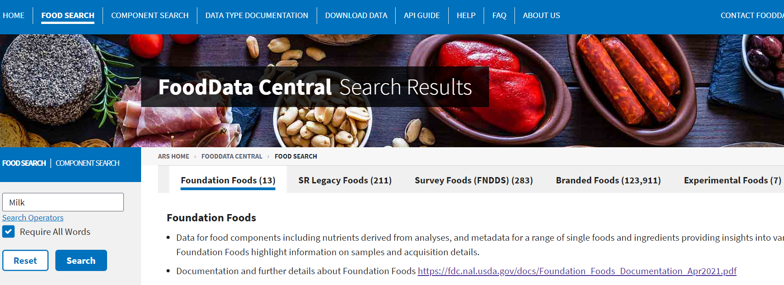
USDA FoodData Central – Online View

Slide 5
Timeline: human nutrition search and SR Database
The USDA was the first federal agency to conduct human nutrition search starting at the end of the 19th century.
For more than a century since then, USDA’s ARS has continued to analyze foods and determine the consumption and dietary patterns of Americans.
This work resulted in the creation of USDA’s National Nutrient Database for Standard Reference (SR). This database is the major source of food composition data in the United States.
SR provides (for now) the foundation for most food composition databases in the public and private sectors (FNDDS – WWEIA included).

Slide 6
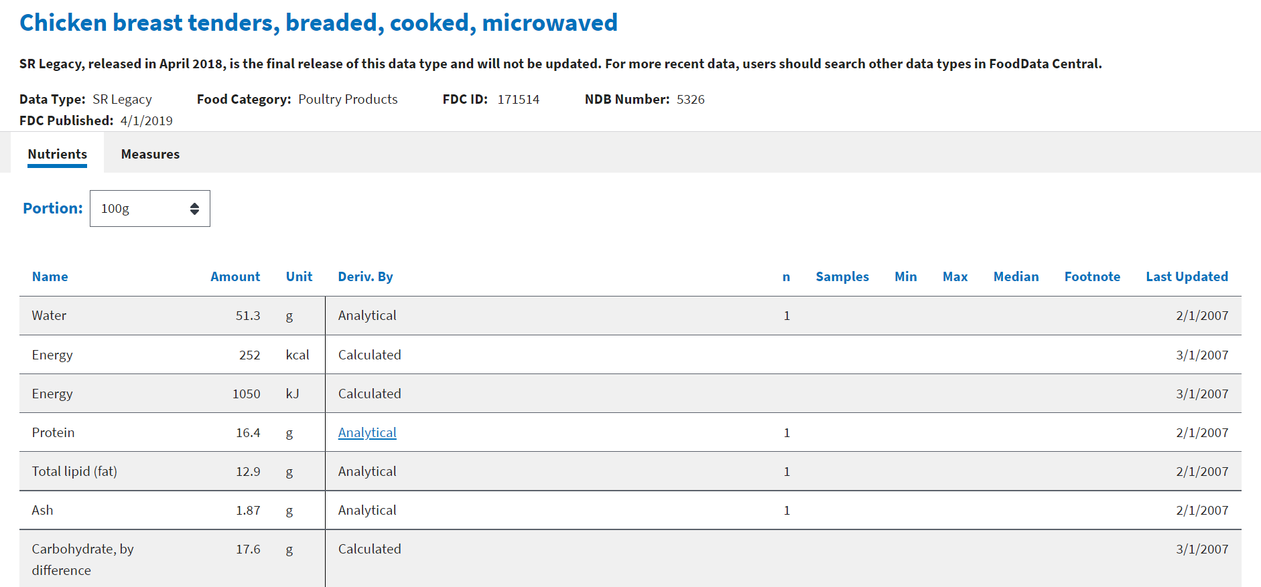
SR online view

Slide 7
SR updating and relevance continuation
Throughout the years, SR database has been continuously and effectively updated.
Effort was put in keeping pace with the evolution in analytical approaches, technology, and agricultural practices that have occurred since the first results had been published.

Slide 8
SR database obsolescence and replacement decision
HOWEVER:
In 2012, the USDA Office of National Programs and the Beltsville Human Nutrition Center decided that
“The existing approach to assembling the SR was no longer viable, given the demands of the US food supply and the limits of USDA's resources, and dramatic change in the USDA National Nutrient Database” (…)
Hence..
(…) “Dramatic change was needed”.

Slide 9
Reasons for approach change decision
Massive increase in the number of prepared and proprietary food products available to consumers
combined by
Rapid and frequent changes in formulations or recipes
makes it
Impossible to analytically determine the composition of all, or even the most important, foods in the food system.

Slide 10
The Global Branded Food Products Database (GBFPD)
The USDA Global Branded Food Products Database (BFPD) is the result of a Public-Private Partnership, whose goal is to enhance public health and the open sharing of nutrient composition of branded and private label foods provided by the food industry. Members of the Public-Private Partnership are:
Agricultural Research Service (ARS), USDA (www.ars.usda.gov)
International Life Sciences Institute ILSI North America (www.ilsina.org)
GS1 US (www.gs1us.org)
1WorldSync (www.1worldsync.com)
Label Insight (www.labelinsight.com)
University of Maryland, Joint Institute for Food Safety and Applied Nutrition (jifsan.umd.edu)

Slide 11
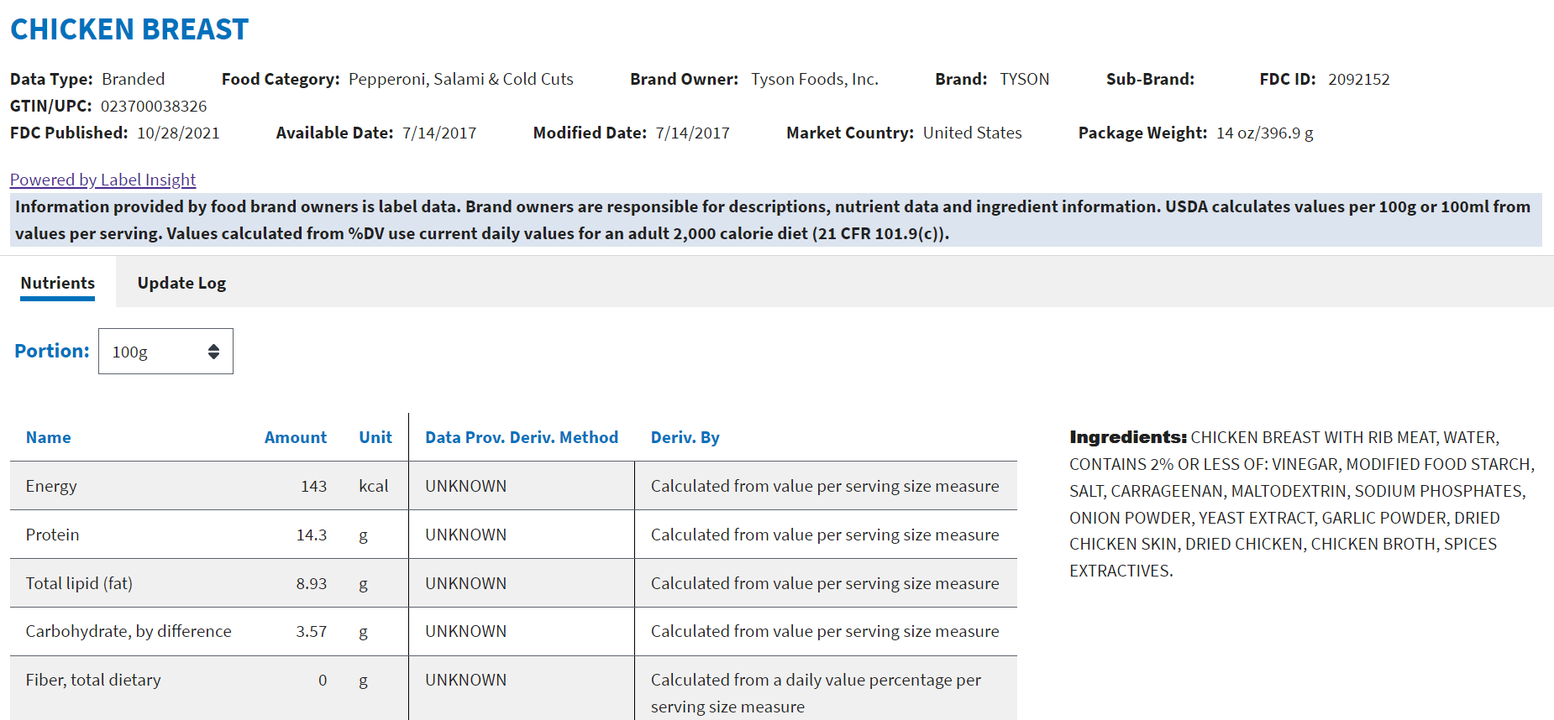
GBFPD online view

Slide 12
Approach Change – The advent of Foundation Foods
The advent of GBFPD prompted a change in the USDA's internal approach to data collection, analysis, and transparent presentation.
Updates to SR were halted and the last version was labeled SR Legacy and released in 2018.
The focus of USDA's internal data acquisition and analysis shifted to commodities and single-ingredient foods, or the foundation foods that are the building blocks of the complex foods in the GBFPD.

Slide 13
Approach Change – The advent of Foundation Foods
The emphasis is on the analysis of individual samples of foods rather than composites.
The user can easily access the variety, location, time of acquisition, and other critical metadata associated with each food.
The result is a focus on single-ingredient foods and a dramatic increase in the amount of data for each food.

Slide 14
Foundation Foods
Foundation Foods is a new food composition data type in the U.S. Department of Agriculture’s (USDA) FoodData Central system.
Foundation Foods contains expanded nutrient and food component profiles and metadata on a range of foods and ingredients.
The data include the individual data points behind the mean values and metadata that include the number of samples, location, dates on which samples were obtained, analytical methods used, and, if appropriate, agricultural information such as cultivar and production practices.

Slide 15
Foundation Foods VS SR Database:
Expanded information on foods
A key feature of Foundation Foods is the ability to see the specific values associated with each independent sample and hence the variability of the analyzed values for each component.
For samples obtained at retail locations, Foundation Foods contains metadata on sample acquisition, including city and state of purchase or manufacture, purchase date, expiration date (if applicable), product lot number, and UPC code (when available).
For samples obtained from agricultural locations, metadata include information such as location (GPS coordinates), cultivar, weather, agricultural practices (e.g., conventional or organic farming), and analytical methodology.

Slide 16
Foundation Foods VS SR Database:
Expanded information on foods
Less emphasis will be placed on mixed dishes or prepared foods.
The inclusion of metadata related to FF will facilitate researchers’ ability to link food-composition data with other important USDA datasets [e.g., Nutrient Uptake and Outcomes Network, the Agricultural Collaborative Research Outcomes System (AgCROS), and Economic Research Service].
FF represents the future of USDA food information because of access to metadata and links to agricultural and production information available across USDA and other federal agencies. One of the goals is to develop systems to include information from nongovernmental sources.

Slide 17
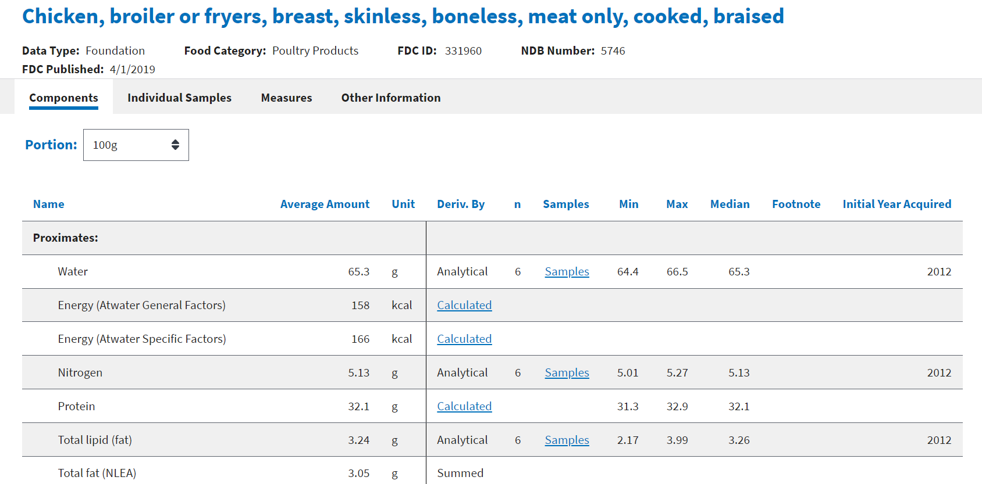
Foundation Foods online view

Slide 18
Foundation Foods online view

Slide 19
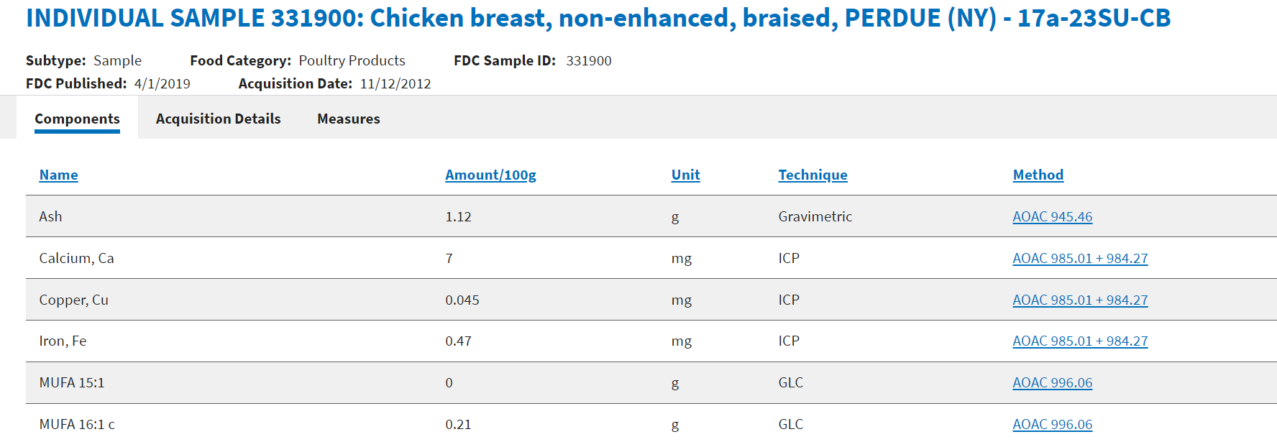
Foundation Foods online view

Slide 20
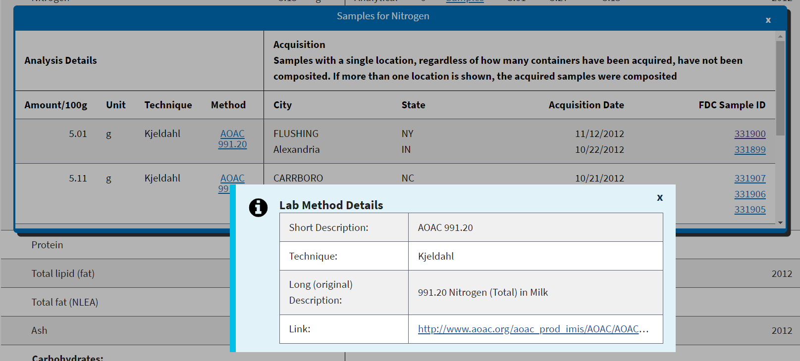
Foundation Foods online view

Slide 21
Expansions to new areas of food information
The evolution of GBFPD and FF also identified 2 additional areas of expansion and consolidation of data accessibility.
Food-composition data within the context of an experimental design or derived from new analytical methodology research do not typically appear in public databases but would be beneficial to researchers if more broadly accessible.
That need identified data for Experimental Foods (EF).
Another data type developed by Beltsville Human Nutrition Research Center's (BHNRC's) Food Surveys Research Group and specific to national nutrition monitoring is the Food and Nutrient Database for Dietary Studies (FNDDS) that has been released every 2 y in concert with the 2-y release of What We Eat in America as part of the NHANES. Including FNDDS as a data type supported the goal of centralized availability. Together, these 5 data types comprise USDA's FoodData Central (FDC).

Slide 22
Food and Nutrient Database for Dietary Studies (FNDDS)
FNDDS provides nutrient values for the foods and beverages reported in What We Eat in America, the dietary intake component of the NHANES.
FNDDS data facilitate analyses of dietary intakes reported in NHANES as well as many other dietary research studies.
The nutrient profiles of a majority of foods and beverages in FNDDS 2017–2018 were generated using a recipe calculation process utilizing 2 or more ingredient codes from FF and SR Legacy data in FDC.
FNDDS includes documentation of the FDC source of each nutrient value for ingredients used in FNDDS and is publicly available.

Slide 23
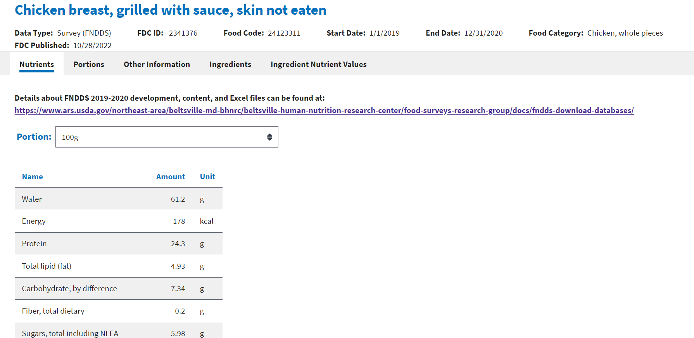
FNDDS online view

Slide 24
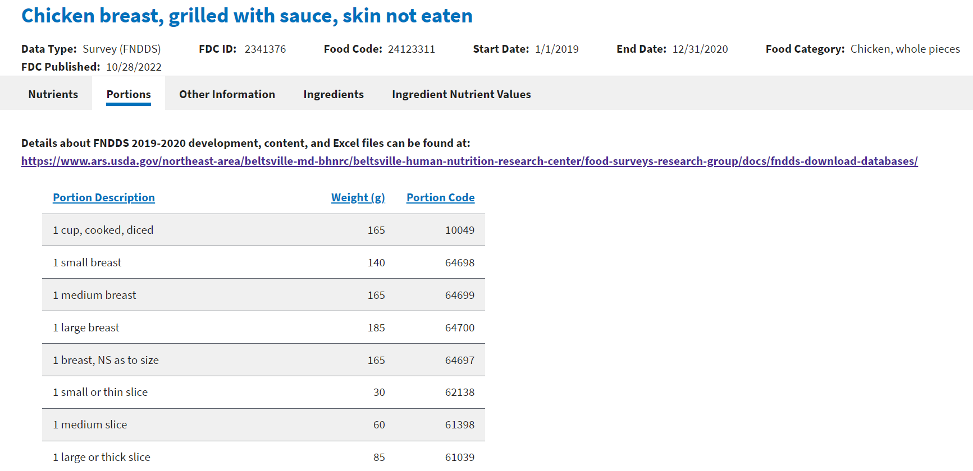
FNDDS online view

Slide 25
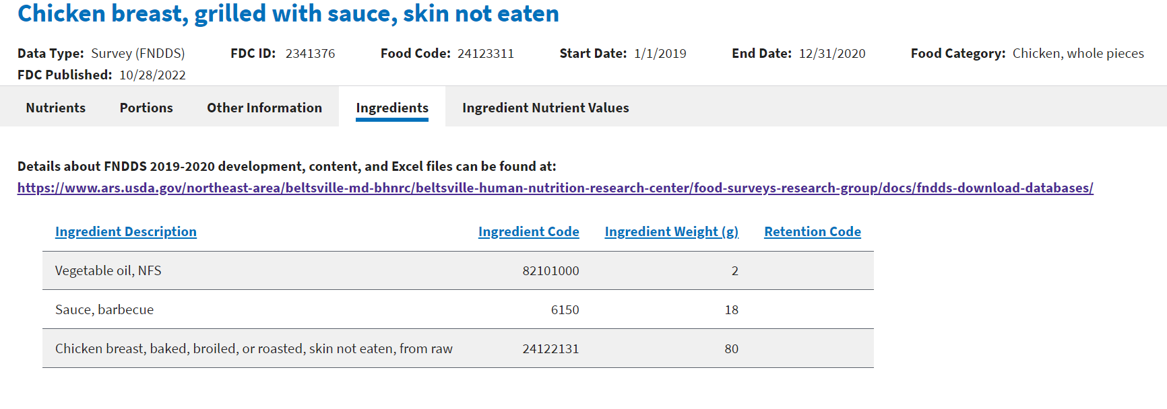
FNDDS online view

Slide 26
Experimental Foods
Data that do not appear in any other dataset searchable from FoodData Central. The overall goal of this data type is to allow users to focus on the research aspects and deeper understanding of factors related to food composition.
Generally, data presented are those that:
1) exist within the context of an experimental design; 2) are derived from new analytical methodology; and/or 3) are based on innovative sampling procedures.
In some cases, data presented may expand information about a specific food that appears in other data types.

Slide 27
Experimental Foods online view

Slide 28
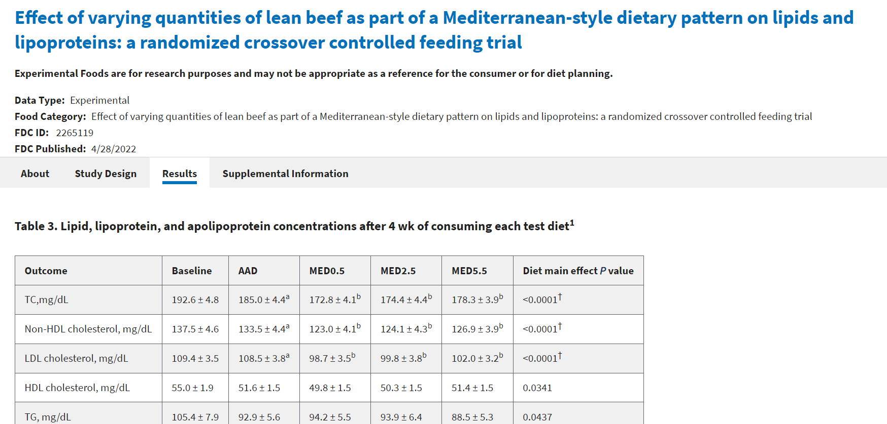
Experimental Foods online view

Slide 29
References
The American Journal of Clinical Nutrition, Volume 115, Issue 3, March 2022, Pages 619–624, https://doi.org/10.1093/ajcn/nqab397
Food Data Central https://fdc.nal.usda.gov/
FNDDS https://www.ars.usda.gov/northeast-area/beltsville-md-bhnrc/beltsville-human-nutrition-research-center/food-surveys-research-group/docs/fndds/

