Slide 1
Strategic Management
Week 5
Strategy Process and
Strategy as Practice

Slide 2
Today’s Agenda and Learning Outcomes: Part 1 – Strategy Process
Understanding the strategy process school
Understanding the deliberate planning approach including criticisms
Understanding the emergent strategy approach including criticisms
Understanding the strategy practice school

Slide 3
Strategy Process research
A process is a series of actions or steps taken in order to achieve a particular end (Dictionary definition)
Process research considers how strategies are formulated, decisions made and changes implemented (Huff and Reger 1987; Johnson et al. 2007)
Pettigrew (1997, p337) defines processes as “... a sequence of individual and collective events, actions, and activities unfolding over time in context”

Slide 4
Pettigrew’s study of ICI
Pettigrew’s (1985) work represents one of the most influential strategy process studies.
It traces the attempts of ICI, one of Britain’s largest corporations at the time, to change its strategy, structures, technologies and corporate culture over a 20 year period.
“... illustrating why and how the content of particular changes and strategies for introducing them are constrained by and enabled by features of the traditions, culture, structure and business of ICI as a whole and each of its divisions..” (Pettigrew 1985).

Slide 5
Processes studies: patterns of continuity and change over time
Pettigrew (1985) argues that change happens in radical, revolutionary periods, alternating with long periods in which the impacts of the changes are absorbed
Johnson’s (1987) process study of change at a UK retailer resonates with this. Johnson (1992) argues that organisations have periods of incremental development or “strategic drift” due to misalignment between the organizational culture and the external environment.

Slide 6
The Process School: humanising strategy research
The process school has ‘humanized’ the strategy field (Chia and MacKay, 2007) by considering organisational phenomena and inner dynamics of organisations (Johnson et al., 2003).
Recognition that these dynamics are largely processes of and between individuals is an achievement of the strategy process school, legitimizing the application of psychological approaches to the study of managers in organizations.
This is a shift from rational economics approaches which view organisations through Morgan’s machine metaphor
source: Mike Zundel, ULMS765 Strategic Organization Module Handbook

Slide 7
The Process School
“An organisation is a social arrangement for achieving controlled performance towards goals that create value” (Boddy, 2005)
The process school is concerned with both controlled performance goals and social arrangements

Slide 8
Key Process School Debate: should strategies be planned out in advance or allowed to unfold?
Deliberate (Prescriptive or Intended) strategy is when strategy is planned carefully in advance
Emergent strategy is when companies respond to market and environmental forces, rather than ‘prescribe’ a long-term plan. Emergent strategy making is sometimes called the incrementalist or learning school.
source: Lynch, R (2011) Strategic Management, 6th Edition, Pearson Education, Chapter 1

Slide 9
Deliberate and Emergent Strategy
Source: De Wit & Meyer, Strategy: context, content and process
Deliberate
Emergent
v Planned
v Emerges incrementally
v Figuring out – analysing
v Finding out - exploring
v Formal, structured
v Informal, unstructured
v Think then Act
v Trial and error
v Forecast
v Experiment & Learn
v Strategic Planning
v Strategic Thinking
Most strategies are neither entirely deliberate nor entirely emergent

Slide 10
Deliberate Strategy Process
Understanding of the deliberate planning approach including criticisms

Slide 11
Strategic planning systems
Strategic planning systems take the form of systematised, step-by-step, procedures to develop an organisation’s strategy.
Deliberate planning is intended strategy, it can be described as rational, linear, instrumental, objective, rigorous and is thus modernist in character
Source: Johnson, Whittington and Scholes (2011) Exploring Strategy,
9th Edition, Pearson Education, Chapter 12

Slide 12
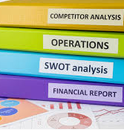
Strategic Plan
May contain all or some of:-
Mission, Vision & Values (may apply to emergent strategy too)
Situational analysis
e.g. competitors, trends, SWOT
Goals, objectives and targets
Risk Assessment
Cost-benefit analysis
Financial forecasts
Summary of main change programmes
Overview of implementation plans with key milestones
Functional plans
Updated Organisation charts
Measuring and monitoring of performance

Slide 13
Linear model of strategic planning
Time
Start of
Planning
Cycle
Mid-Cycle
End of
Planning
Cycle
Review
Results and
Start new
Planning Cycle

Slide 14
The benefits of deliberate planning:
Aids complex thinking
Helps to structure analysis and thinking about complex strategic problems
Encourage a longer term view of strategy than might otherwise occur
Can provide a remedy for strategic drift
Can reduce resource wastage
Based on ‘get it right first time’, eliminates wasteful trial and error
Fits some organizational cultures
May work in relatively stable environments
source: Johnson, Scholes & Whittington (2008)
Exploring Corporate Strategy (Ed 8), FT Prentice Hall, pp403

Slide 15
The benefits of deliberate planning: psychological benefits
There are additional psychological benefits:
can provide opportunities for involvement
leading to a sense of ownership
provides security to managers
re-assures managers that the strategy is ‘logical’
Expectations and responsibilities are known
Source: Johnson, Whittington and Scholes (2011) Exploring Strategy, 9th Edition, Pearson Education, Chapter 12 ​

Slide 16
Criticisms of Deliberate Planning School
Dampening of Innovation – planning process stifles creativity
difficult to combine creative thinking and logical planning and avoid ‘information overload’ or ‘analysis paralysis’.
Illusion of Control
A reliance on planning may simply give the illusion of control over a organisation's future
Lack of ownership and detachment
if planning is ceded to strategic planners because line managers are too busy or not fully involved and committed
the result is likely to be a well-documented plan that is never implemented
Strategies do not typically develop through planning processes alone
organisations need flexibility to deviate from the plan and to add emergent initiatives
source: Johnson, Scholes & Whittington (2008) Exploring Corporate Strategy (Ed 8), FT Prentice Hall,

Slide 17
Criticisms of Deliberate Planning School
Separates THINKING and ACTION
Top management think – the rest ‘do’
Restricts learning
Learning is restricted to the first and last stages of the process (analysis and review)
Top down
assumes top elites know more about the intricacies of the business than specialists, scientists, experts
Empirical research suggests it rarely works in practice
Unintended consequences abound!

Slide 18
Criticisms of Deliberate Planning School: costly waste of time and effort
Senior executives generally agree that crafting strategy is one of the most important parts of their job. As a result, most companies invest significant time and effort in a formal, annual strategic-planning process
Yet the extraordinary reality is that few executives think this time-consuming process pays off, and many CEOs complain that their strategic-planning process yields few new ideas and is often fraught with politics
“We do corporate planning in the first two weeks of April, then we get back on with our jobs.”(in Johnson, Scholes & Whittington, 2005)
Beinhocker D. and Kaplan S., (2002) McKinsey Quarterly

Slide 19
High velocity environments
‘…because the innovative organisation must respond continuously to a complex, unpredictable environment, it cannot rely on deliberate strategy. In other words, it cannot predetermine precise patterns in its activities and then impose them on its work through some kind of formal planning process’ (Mintzberg, 1989, p210)

Slide 20
Criticisms of Deliberate Planning School: Mintzberg argues that a detailed strategy can be dangerous - there is nothing worse than a poor strategy, fully implemented
Mintzberg, Henry (1978) Patterns In Strategy Formation, Management Science, May 1978; 24, 9;

Slide 21
Emergent/Incremental Strategy Process IT IS STILL STRATEGY! IT IS STILL STRATEGIC!
Understanding of the emergent strategy approach including criticisms

Slide 22
Emergent strategy
An emergent strategy comes about through a series of decisions - a pattern which becomes clear over time:
……strategy not as a ‘grand plan’, but as a developing “pattern in a stream of decisions or actions” (Mintzberg & McHugh, 1985)
Source: Johnson, Whittington and Scholes (2011) Exploring Strategy, 9th Edition, Pearson Education, Chapter 12 ​

Slide 23
Emergent and Incremental strategy process: the Learning School approach
Strategies emerge as people come to learn about a situation, through doing and experimenting
“A single action can be taken, feedback can be received, and the process can continue until the organization converges on the pattern that becomes its strategy”
Strategy is thus a pattern of decisions
Further reading: Mintzberg et el (2008), Strategy Safari, 2nd Edition, Chapter 7

Slide 24
Emergence: a “Grass Roots” model of strategy formation
The process of strategy formation can be over-managed
Sometimes it is more important to let patterns emerge than to force an artificial consistency upon an organization prematurely
MINTZBERG, H. & MCHUGH, A. 1985. Strategy formation in an adhocracy. Administrative Science Quarterly, 30, 160-197.

Slide 25
Emergence: a “Grass Roots” model of strategy formation
Strategies can take root in strange places, wherever people have the capacity to learn and the resources to support that capacity
Such strategies become organizational when the patterns proliferate, to pervade the behavior of the organization at large. The emergent strategy, like certain weeds, becomes what is valued
To manage this process is not to preconceive strategies but to recognize their emergence and intervene when appropriate. A destructive weed, once noticed, is best uprooted immediately; but one that seems capable of bearing fruit is worth watching, perhaps cultivating, even building a hothouse around.
MINTZBERG, H. & MCHUGH, A. 1985. Strategy formation in an adhocracy. Administrative Science Quarterly, 30, 160-197.

Slide 26
The Honda Story (US Entry in 1959)
Account 1 - Deliberate
Honda’s US entry strategy is portrayed as a deliberate approach by a firm “dedicated to being the low price producer, utilizing its dominant market position in Japan to force entry into the U.S. market, expanding that market by redefining a leisure class segment, and exploiting its comparative advantage via aggressive pricing and advertising” to achieve economies of scale.
Account 2 - Emergent
“We used the Honda 50s ourselves to ride around Los Angeles on errands. They attracted a lot of attention…we still hesitated to push the 50cc bikes out of fear they might harm our image in a heavily macho market. But when the larger bikes started breaking, we had no choice. We let the 50cc bikes move. And surprisingly, the retailers who wanted to sell them…were sporting goods stores.”
Further reading: Pascale, R. (1984) ‘Perspectives on Strategy: The Real Story Behind Honda's Success’, California Management Review , Vol. XXVI, No. 3, Spring 1984

Slide 27
Bottom Up, Top Down and Lateral
Encouragement of informal communication networks within organisations to improve the flow of ideas and encourage innovative thinking
Adaptability
Ability to respond to changing circumstances without waiting for planning cycle
The use of temporary structures such as task forces and project teams to implement change
Experimenting
The use of pragmatic problem solving and experimentation as a route to developing new strategies. Strategic change consists of the accumulation of successful experiments.
Trial and error.
Learning by doing.
Broad Direction
Strategy is orchestrated through the shared visions, missions and values generated and by senior management
Emergent Approach Characteristics
Source: Lynch, R. (2012) Strategic Management 6th ed

Slide 28
Advantages of Emergent strategy process
Creates a learning organization
Top down, bottom up and lateral
Flexible
Adaptive
Trial and error
Experimentation
Emphasises strategic thinking over programmed activity
Places trust in experts in the organisation

Slide 29
Criticisms of Emergent strategy approach
Fragmentation
The left hand does not know what the right hand is doing
Chaos rather than control
Wasted resources
Does not work for large investment projects
Can be readily distorted by power, politics, misinformation
May lead to strategic drift

Slide 30
Criticisms of the Process School
Strategy as Practice (SAP) scholars see the process school as focussing too much at the firm level and organisational outcomes (growth, performance etc.) and not getting close enough to practice
Johnson et al. (2007:10) argue that the focus of process research ‘was the search for a relationship between the presence of such planning and performance outcomes of the firm…neglecting almost entirely the detailed activities involved in such planning’
Strategy Process research has tended to focus at the organisational level and at patterns of continuity and change through time, whilst SAP focuses on the detail of human activity and argues that ‘managers manage activities’

Slide 31
Deliberate and Emergent Strategy
Most organisations are neither entirely deliberate or entirely emergent in strategy development
What does this mean in practice?
Most companies will have some form of prescriptive plan with objectives, strategies and implementation issues like costs and timetables
Some, but not all, companies will also take a more emergent approach with some additional resources devoted to new ideas, where the outcome is fuzzy and experimental with no guarantee of success (similar to ambidextrous organisations)
When strategic drift occurs due to misplaced incrementalism, a deliberate strategy process might be called upon to readjust the organisation and address the drift
Deliberate strategy processes are usually required/adopted for large capital investment projets
Source: Lynch,R (2012) Strategic Management 6th ed chapter 2

Slide 32
Agenda and Learning Outcomes - Strategy as Practice
Understanding the Strategy as Practice perspective
01
Understanding the limitations and criticisms of the Strategy as Practice perspective
02

Slide 33
Strategy as Practice
This is not a theoretcial framework that can be applied
It is a research agenda to examine what happens in organisations
Perhaps in the future some models/frameworks will emerge...

Slide 34
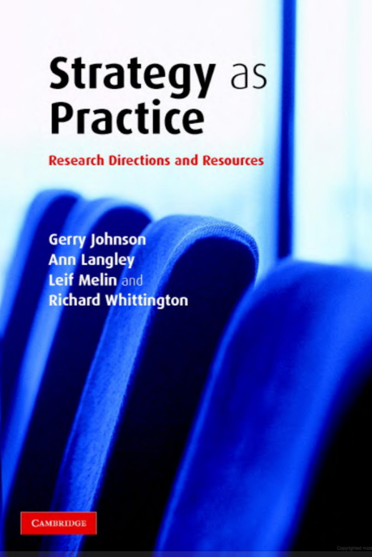
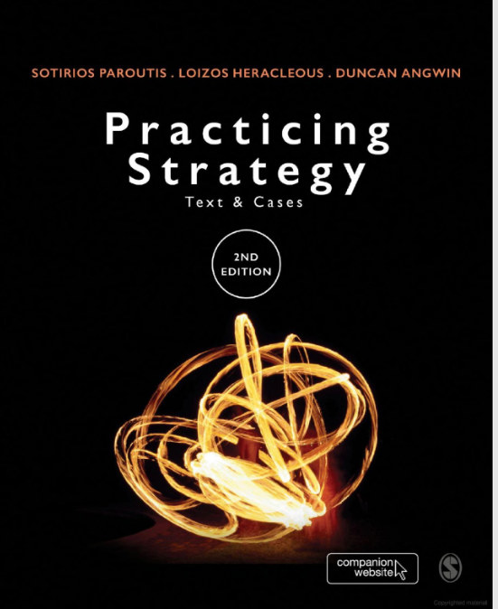
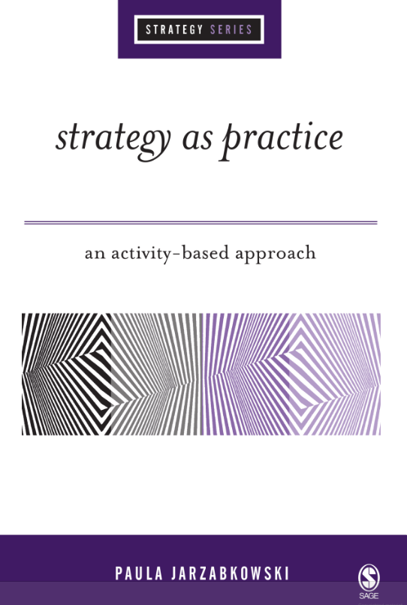
Key Texts
2007
2005

Slide 35
Key Authors
Richard Whittington
Paula Jarzabkowski
Julia Balogun
Gerry Johnson

Slide 36
From Strategy to Strategizing
Strategy process research
Example questions: what strategy process or pattern does an organisation follow over time? How does an organisation’s strategy unfold? How does an organisation adapt to change or manage innovation?
Focus: at organisation level

Slide 37
From Strategy to Strategizing
Strategy as Practice research is concerned with:
How do strategy actors such as managers ‘do’ strategy? What activities make up strategy work (strategizing)? How is strategy work socially accomplished?
How is strategy work shaped by or shaping institutional macro / societal level context? How is strategy work shaped by popular management tools like five forces? How can strategy work influence “grand challenges” such as poverty or climate change?
Focus: micro focus at strategy actor level and also linking between micro and meso (organisation or industry) and wider macro level (societal level)

