Slide 1
Culture and Change Limitations and Critique

Slide 2
“Faced with pressures for change, managers are likely to deal with the situation in ways which are in line with the paradigm and the cultural, social and political norms of organizational life.
Culture as a barrier to strategic change – and a trigger for ‘strategic
drift’ (1)
This raises difficulties when managing strategic change for it may be that the action required is outside the scope of the paradigm and the constraints of the cultural web-that members of the organization would be required to change
substantially their core beliefs or ‘the way we do
things around here’.
Desirable as this may be, the evidence is that this
does not occur easily…”
JOHNSON, G. 1992. Managing strategic change - strategy, culture and action. Long Range Planning, 25, 28-36.⁴³

Slide 3
Culture as a barrier to strategic change – and a trigger for ‘strategic drift’ (2)
JOHNSON, G. 1992. Managing strategic change - strategy, culture and action. Long Range Planning, 25, 28-36.

Slide 4
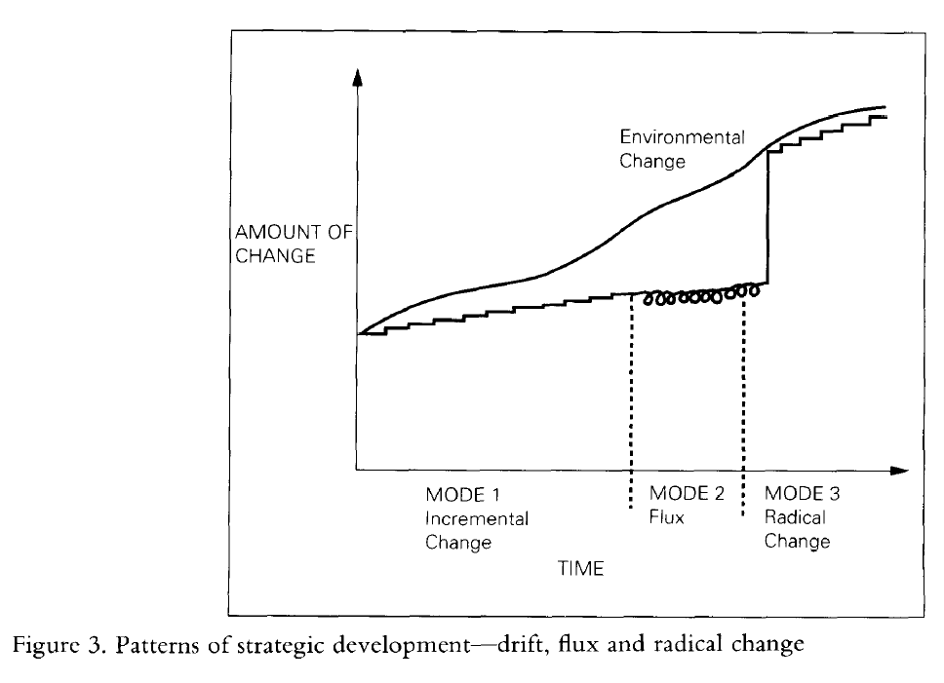
Strategic drift
JOHNSON, G. 1992.
Managing strategic change - strategy, culture and action.
Long Range Planning, 25, 28-36.

Slide 5
The tendency towards strategic drift
JOHNSON, G. 1992. Managing strategic change - strategy, culture and action. Long Range Planning, 25, 28-36.

Slide 6
Criticisms of cultural web
Sub cultures: Does an organisation have one culture? Might the culture differ depending on different product divisions or different geographic locations? Does the model capture this?
Low Prescriptive benefit: even if you identify important constraining influences in the culture, how easy is it to change an organisation’s culture?
47
JOHNSON, G., WHITTINGTON, R., SCHOLES, K., ANGWIN, D., & REGNER, P. 2016. Exploring Strategy: Text and cases. Pearson Education.

Slide 7
What is organisation culture?
Is it something the organisation 'has' like a resource
that can be owned and manipulated
OR
Is it something the organisation 'is'; fundamental to the very fabric of the 'way things are done around here', about values and beliefs, and thus beyond the remit of 'management'
48

Slide 8
Criticisms of Change Management
Static and Linear: Dominant theories of change such as Kurt Lewin’s models are based on rational and linear models of thinking. In reality the
organization does not “refreeze”
- it is in a constant state of flux
Change agents: There are implicit assumptions that change can be managed and that if there is a ‘change agent’ the change agent(s) know best.
Jarrett M. (2003) ‘The seven myths of change management’, Business Strategy Review Winter 2003 Volume 14 Issue 4
49

Slide 9
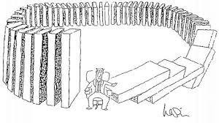
Criticisms of Change Management
Rapid development of change and its divergent origins means that change is not something that can be managed with certainty. Outcomes can be both divergent and unexpected. Change management initiatives can lead to unintended consequences.
This shares many of the principles of complexity theory applied to organisations by Ralph Stacey.
50
Jarrett M. (2003) ‘The seven myths of change management’, Business Strategy Review Winter 2003 Volume 14 Issue 4

Slide 10
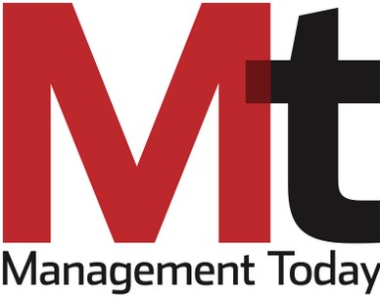
Change management can result in costly failures
“So began yet another exercise in corporate
restructuring….First, before deciding on how to go about it, they did what any well-paid senior executives do in a similar situation: Hire a team of management consultants.”
“End result: A disgruntled, change-resistant and weakened work force, a management bitter towards their ‘lazy’ and ‘disloyal’ employees, an over burdened HR struggling to fill empty slots vacated by the most capable employees and as a cherry on top of the cake, a big hefty bill from a consultancy firm. Is that really money well spent?”
51
https://www.managementtoday.co.uk/everyones-management-consulting-merry-go-round/article/1341638

Slide 11
Summary of Cultural Change Perspective
Cultural and historical influences both inform and constrain the strategic development of organisations.
The seven elements of the cultural web may be useful for analysing organisational cultures and their relationships to strategic change.
Historic and cultural influences may give rise to strategic drift as strategy develops incrementally on the basis of such influences and fails to keep pace with a changing environment.
Is your organizational case study experiencing ‘strategic drift’?
There are criticisms of both the cultural web approach and the change management literature

