Slide 1
HelTH- A branded food composition database for Greece and potential applications
ΑGRICULTURAL UNIVERSITY OF ATHENS
DEPARTMENT OF FOOD SCIENCE & HUMAN NUTRITION
Prof Maria Kapsokefalou

Slide 2
Branded Food Composition Databases (BFCDs)
Processed foods can make up almost 70% of the total energy intake, especially in the Western diet
generic FCDBs can not express the variability of processed foods
Need of complete, current, reliable food data
Need of studying processed food products
Trend towards processed food products

Slide 3
DATABASE DESCRIPTION

Slide 4
Food Data
The first and only branded food composition database for Greece, created in the Laboratory of Food Chemistry & Analysis, Department of Food Science & Human Nutrition, Agricultural University of Athens
It started in 2019 and it currently includes >5000 foods sold in Greek Supermarkets
Data collection is taking place in waves through online super-markets
The 2020 version was used for this analysis (n=4002)
Katidi et al 2021 Food Chem Jun 15;347:129010. doi: 10.1016/j.foodchem.2021.129010

Slide 5
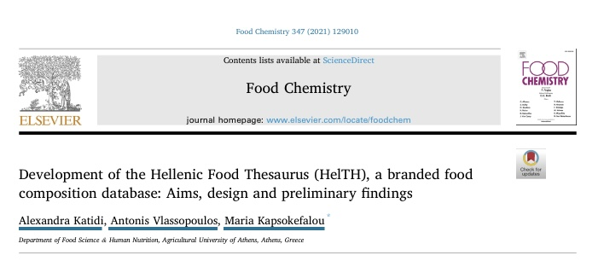
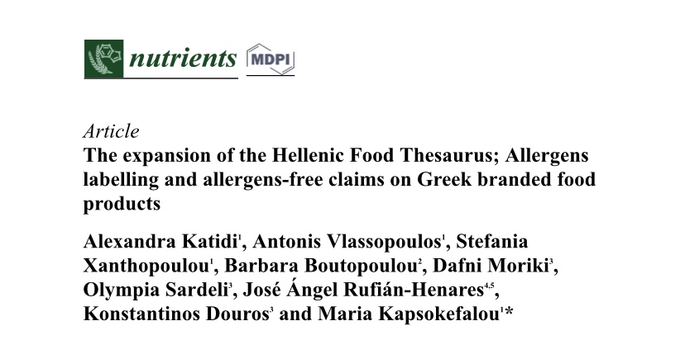
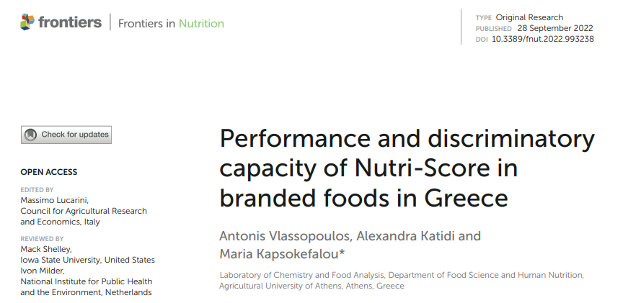
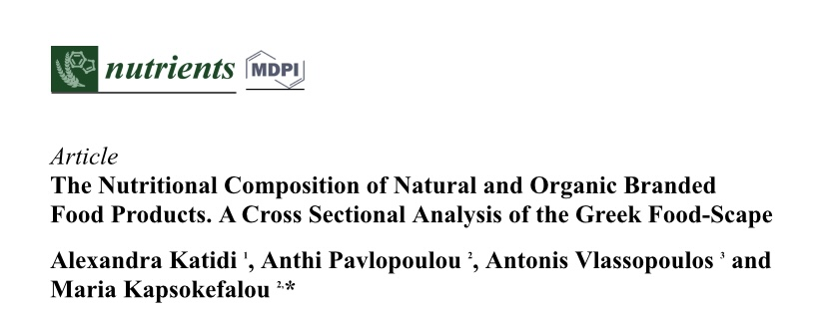
HelTH publications
02
03
04
Database Architecture & Data
Applications

Slide 6
Overall Structure

Slide 7
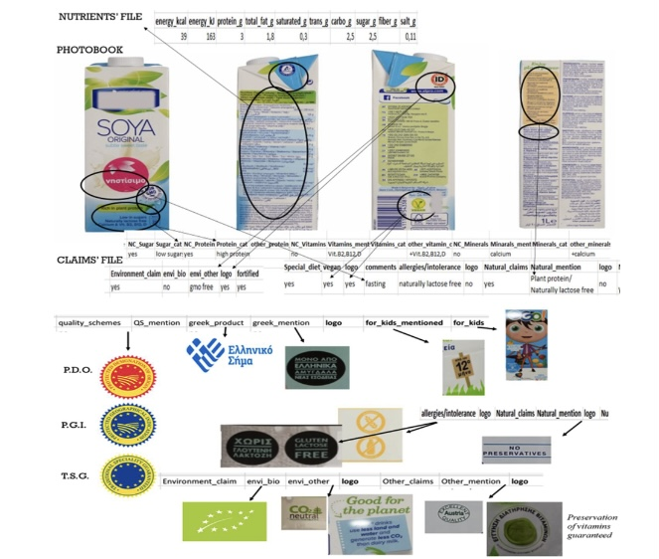
The pack is our data source
All information made available on pack is indexed in a single database
A systematic process is described and published in a manual

Slide 8
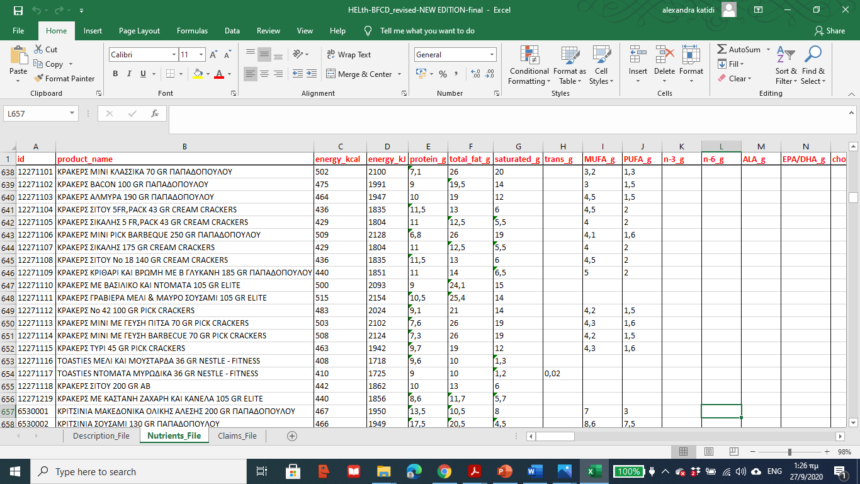
Demo of HelTH

Slide 9
APPLICATIONS

Slide 10
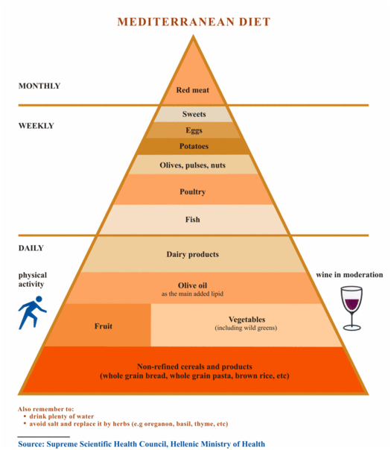
Mediterranean Diet variations
The “original” publication by Prof A. Trichopoulou
With a strong focus on the traditional diet of inhabitants of the island of Crete, Greece
Excludes any non traditional and ultra processed foods.
Even imported foods are not considered a part of it.

Slide 11
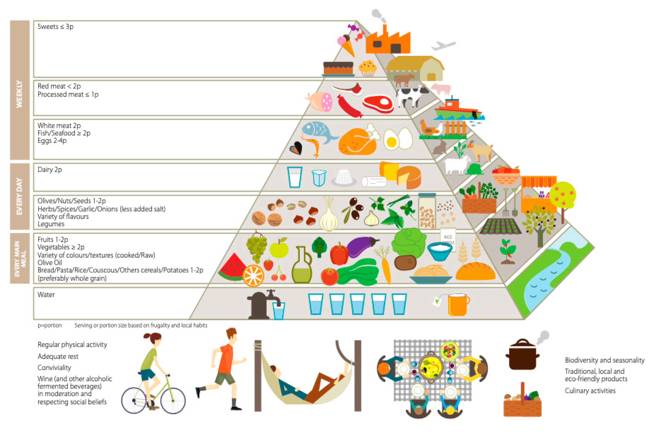
Mediterranean Diet variations
The Sustainable Med Diet Pyramid
An overarching paradigm for the Mediterranean Basin
More foods are included
Some degree of processing is allowed
Key difference is the positioning of meats and sweets

Slide 12
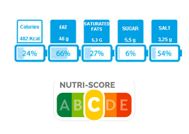
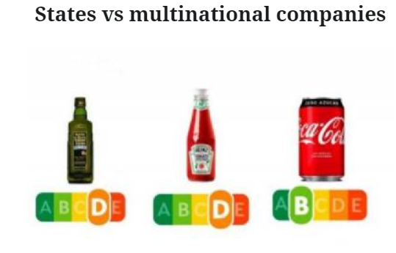
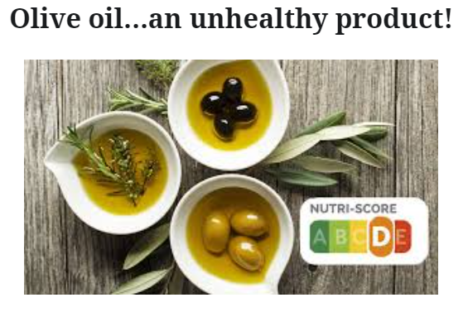
The Nutri-Score Debate
The EU Commission is set to decide on a Nutrient Profiling Scheme for all Member States by the end of 2022 (Q1 2023)
Nutri-Score is the strongest candidate
There has been major push back on whether is supports the principles of the Mediterranean Diet

Slide 13
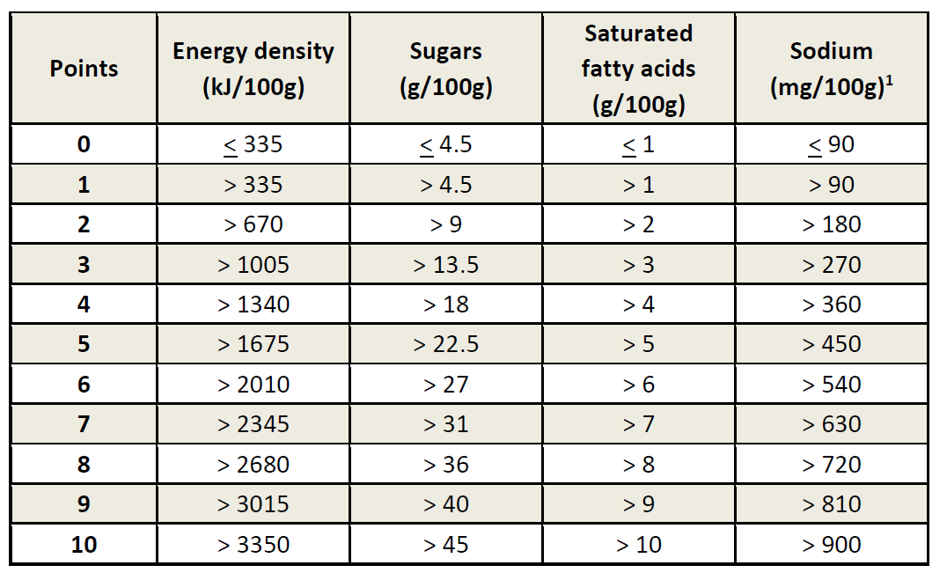
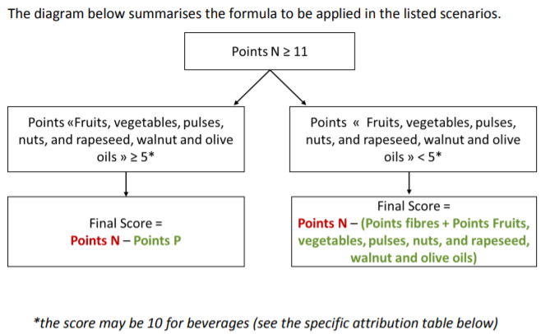
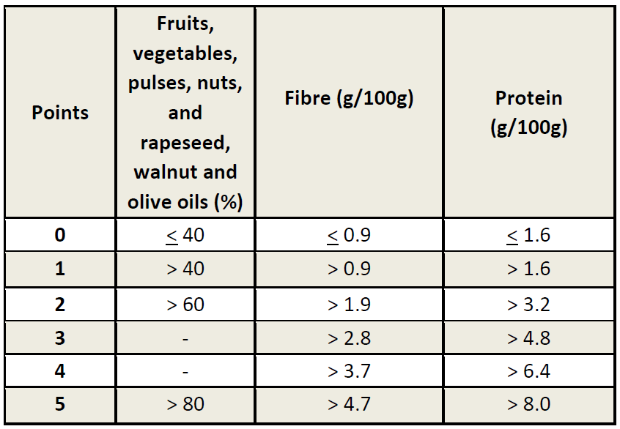
Nutri Score calculation
1
Negative Nutrients:
Calculated first
Positive Nutrients: Accounted case-wise
3
2
Energy, Total Sugars, SFA, Sodium, Protein and Fiber:
Nutrition Declaration
Fruits, vegetables, pulses, nuts and oils:
Manually estimated from ingredient list

Slide 14
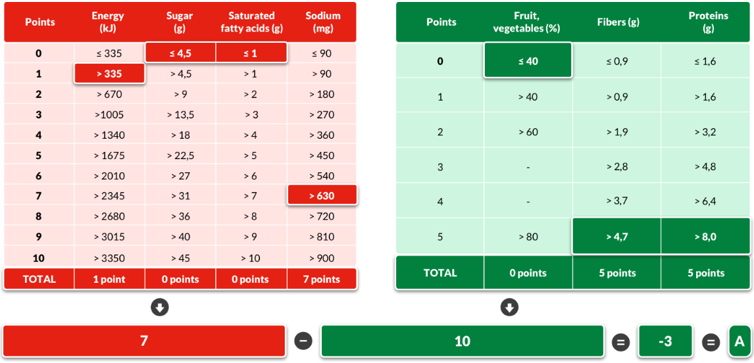
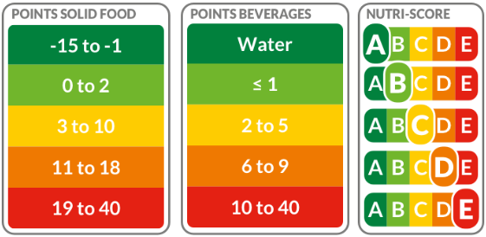
Nutri Score calculation
The score is calculated as a continuous variable and is then converted to a 5-tier categorical variable

Slide 15
Food Classification
All foods were classified in 4 categories:
In scope of the Greek Mediterranean Diet Pyramid
In scope of the Sustainable Mediterranean Diet Pyramid
Traditional Foods not in scope of the Pyramid
Modern Foods

Slide 16
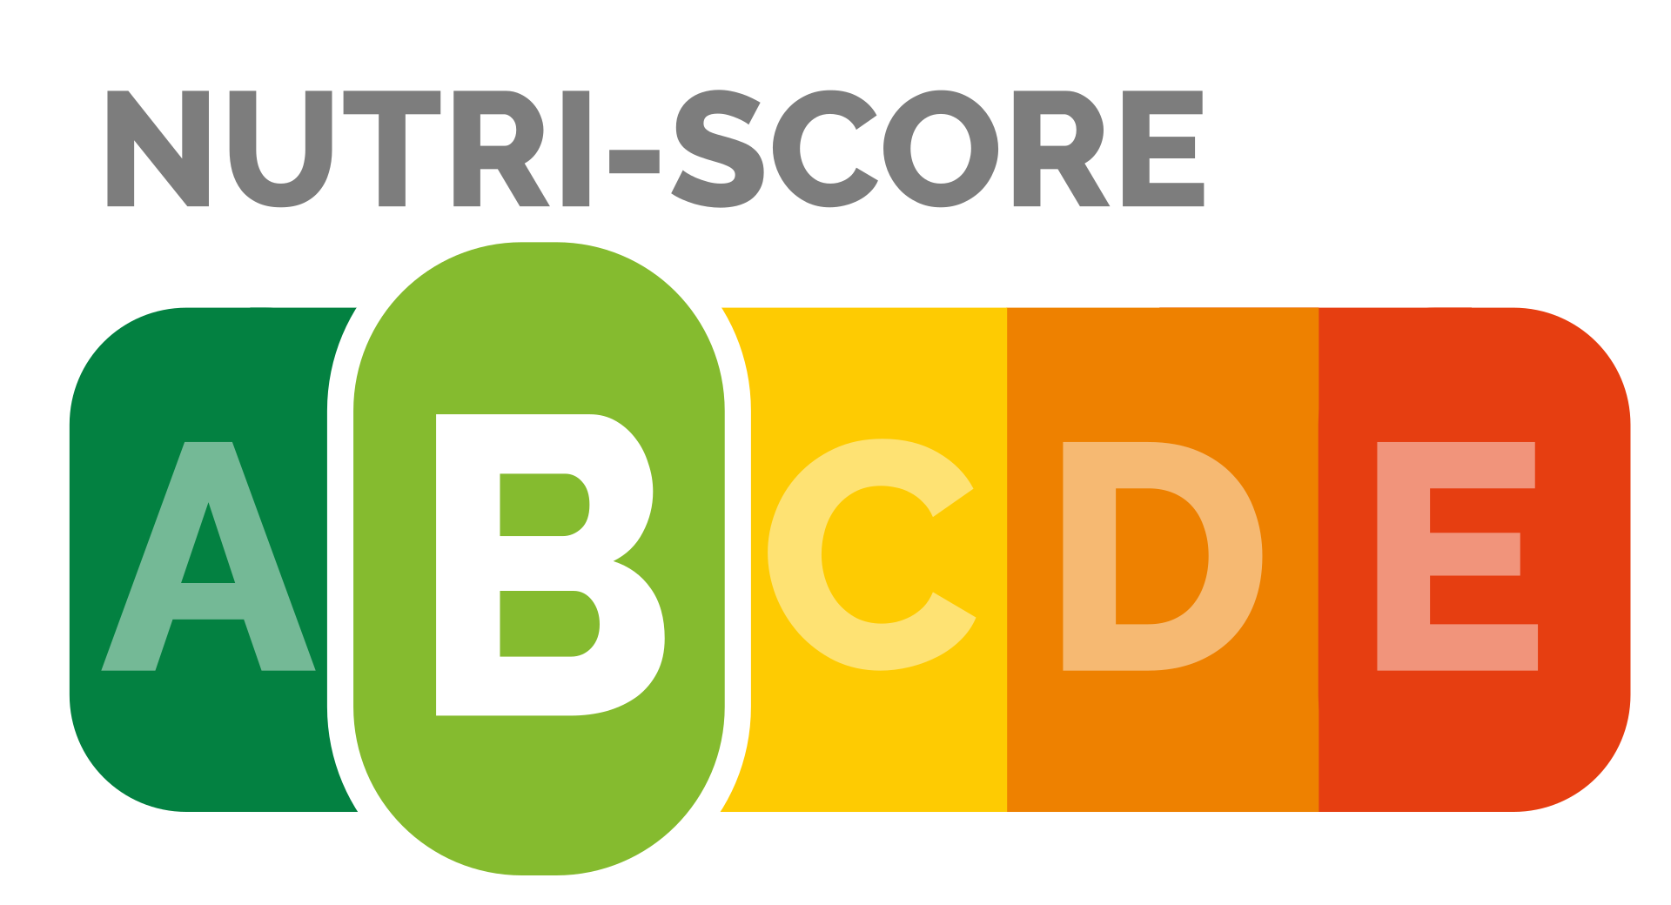
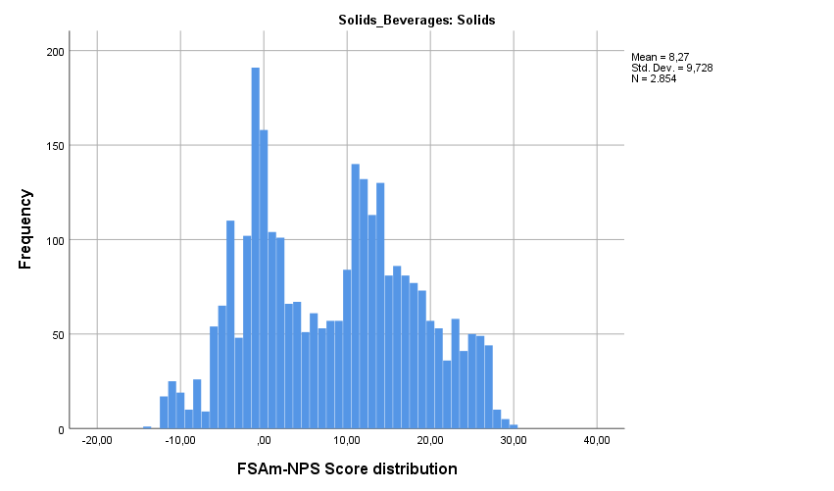
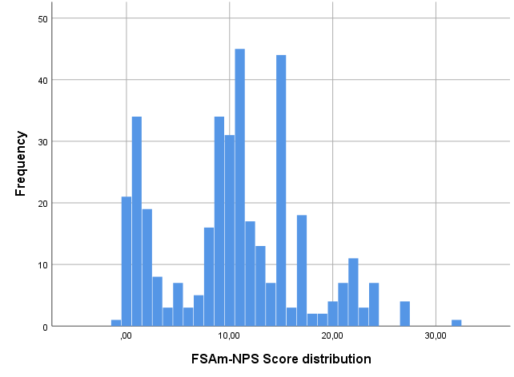
Distribution of Nutri-Score in packaged foods in Greece
Nutri-Score data were available for n=3224 foods
Foods
Beverages
Figure 1. Distribution of FSAm-NPS Score among branded solid foods and beverages in the HelTH FCDB (n=3224).

Slide 17
Nutri-Score per Food Group
These were split in 13 major food categories according to LanguaL classification
Food Category | Nutri-Score Median (Q1, Q3)
Milk, Milk Products & Substitutes (n=574) | 3 (0, 15)
Eggs or Egg Products (n=30) | 0 (-1, 0)
Meat or Meat Products (n=103) | 15,5 (11, 19)
Fish & Seafood (n=58) | 5 (2, 14)
Fats & Oils (n=63) | 13 (9, 19)
Grains or Grain Products (n=935) | 9 (-1, 15)
Nuts & Seeds (n=114) | 8 (2,13)
Vegetables or vegetable products (n=210) | -6 (-10, -5)
Fruits or fruit products (n=37) | 1 (-2, 4)
Sugar or sugar products (n=288) | 22 (14, 26)
Non milk beverages (n=370) | 11 (5, 15)
Ready Meals (n=76) | -0.5 (-4, 2)
Miscellaneous (n=278) | 11 (5,15)
Total (n=3224) | 10 (0, 16)
Almost all foods in the Vegetables category were scored A
Includes Pulses and Vegetables

Slide 18
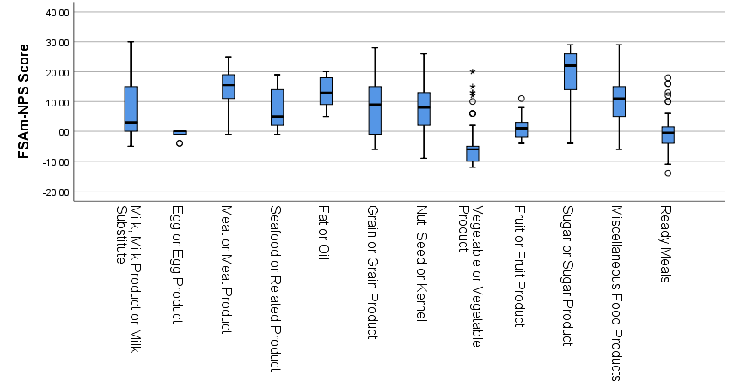
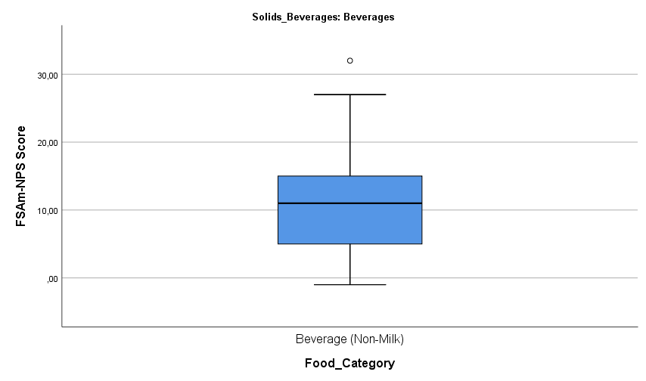
Nutri-Score per Food Group
These were split in 13 major food categories according to LanguaL classification
Eggs were scored as either A or B,
Fruits were scored A to C
The majority of Ready Meals were scored A to B
Figure 2 Overall distribution of products within the main food categories (n=3224).

Slide 19
Distribution of foods according to the Med Diet
Only a small proportion of foods (25%) would be considered eligible under the Greek Mediterranean Diet Guidelines
The newer definition of the Mediterranean Diet covers 57,9% of the foods sold in Greek Supermarkets
A large proportion of foods currently available in the Greek supermarket are novel, or include novel ingredients/processes, or are non-Mediterranean

Slide 20
Traditional vs Non-Traditional Foods
Foods that are eligible according to the Greek Mediterranean Diet Pyramid receive a better Nutri-Score compared to all other categories (p<0,05)
The Sustainable Mediterranean Diet Pyramid includes more foods with higher Nutri-Score (mainly at the top tiers, data not shown)
Category | Nutri-Score Mean ± SD | Nutri-Score Category Mode (Range)
Greek Med Diet | 4,94 ± 10,5 | A (A-E)
Sustainable Med Diet | 10,76 ± 9,7 | E (A-E)
Traditional | 8,22 ± 8,4 | D (A-E)
Modern foods | 8,63 ± 7,9 | D (A-E)
Nutri-Score performance was not different among traditional composite dishes and non-traditional foods

Slide 21
Nurti-Score Alignment with Greek Med Diet Pyramid
Nutri-Score seems to better identify foods in the top of the pyramid
Pyramid Group | Nutri-Score Mean ± SD | Nutri-Score Category Mode (Range)
Red Meat | 16,68 ± 4,6 | D (C-E)
Sweets | 15,43 ± 6,9 | D (A-E)
Eggs | -0,63 ± 1,1 | B (A-B)
Potatoes | -0,63 ± 1,6 | B (A-B)
Olives, Nuts, Pulses | 1,36 ± 10,5 | A (A-E)
Poultry | n/a | n/a
Fish | 5,29 ± 5,6 | B (A-D)
Dairy | 5,23 ± 7,5 | A (A-E)
Olive oil | n/a | C
Fruits & Vegetables | -3,11 ± 8,8 | A (A-E)
Non-refined Cereals | 2,48 ± 7,7 | A (A-E)
There are some issues with categories in the middle of the pyramid

Slide 22
Alignment with Greek Med Diet Pyramid
When compared to the latest Med Diet pyramid, Nutri-Score shows greater granularity
Pyramid Group | Nutri-Score Mean ± SD | Nutri-Score Category Mode (Range)
Sweets | 15,18 ± 7,7 | E (A-E)
Red & processed meat | 16,88 ± 4,0 | D (A-E)
White meat, fish, eggs | 2,94 ± 5,5 | B (A-E)
Dairy | 5,07 ± 7,6 | B (A-E)
Olives, nuts, seeds, legumes | 1,23 ± 10,5 | A (A-E)
Fruits, Vegetables & Cereals | -0,39 ± 7,5 | A (A-E)
There are foods available in all Scores for each pyramid Tier

Slide 23
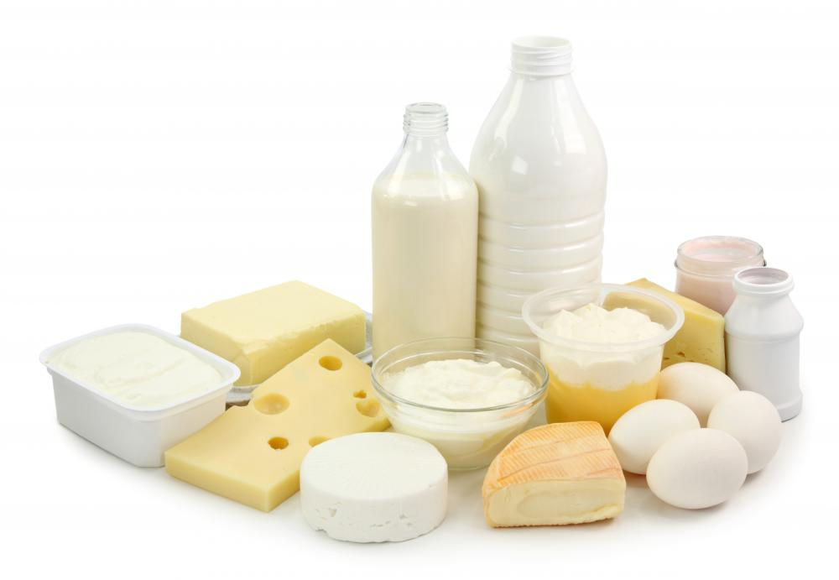
Differentiation capacity within Med Diet Tier
Food Group | Nutri-Score Mean ± SD | Nutri-Score Category Mode (Range)
Milk | 1,62 ± 6,3 | A (A-E)
Yogurt | 0,07 ± 1,5 | B (A-C)
Cheese | 12,5 ± 5,6 | D (A-E)
Evaporated Milk, Chocolate Milk and Kids Yogurts have higher Nutri-Score compared to the unsweetened variants
Cured cheeses receive 4 times higher Nutri-Score compared to uncured cheeses (3,7 ± 4,8 vs 14, ± 3,2; p<0,05)
Food Group | Energy (kcal) Mean ± SD | Total Fat (g) Mean ± SD | Protein (g) Mean ± SD | Sodium (mg) Mean ± SD
Milk | 69,97 ± 55,0 | 2,56 ± 1,8 | 4,08 ± 3,8 | 54,90 ± 51,8
Yogurt | 84,81 ± 23,1 | 3,07 ± 2,6 | 6,29 ± 2,1 | 51,49 ± 20,5
Cheese | 293,58 ± 84,1 | 22,49± 8,2 | 20,94 ± 7,4 | 748,10 ± 332,7

Slide 24
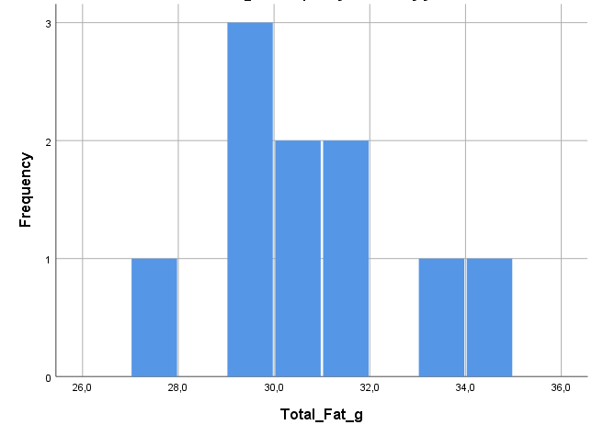
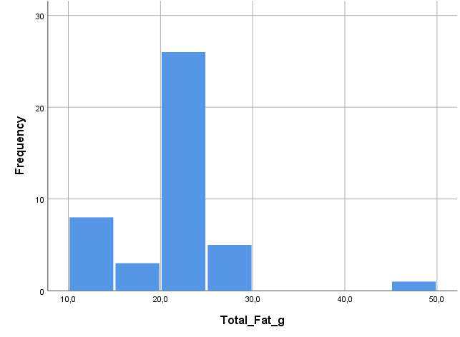
The Score reflect differences within subcategories
Anthotyro
Uncured cheese
Semi-hard cured cheese
Manouri
Gruyere
Kefalotyri

Slide 25
Analysis of Claims on Packaged Foods
Total number of products (n=4002)
Products with missing claims data (n=343)
Products with complete claims’ data (n=3681)
Products with missing nutrients’ data (n=416)
Products with complete claims’ & nutrients data (n=3243)

Slide 26
Prevalence of claims on branded foods sold in the Greek market
Claims Prevalence
Products in HelTH | Products with Claims (every on-pack communication) | Products with Health Claims | Products with Nutrition Claims | Products with other Claims (social/ environmental/quality/ health-related) | Products with natural/bio Claims | Products with Special diet Claims
4002 (100%) | 2402 (60%) | 110 (2.7%) | 896 (21.7%) | 334 (8.3%) | 920 (23%) | 280 (7%)

Slide 27
 | Nutrition Claim | Health Claim
Food Categories & Subcategories | n (%) | n (%)
Milk, Milk Product or Milk Substitute (n=693)
Milk (n=175) | 97(55,4) | 19(10,9)
Yogurt (n=172) | 111(64,5) | 12(7)
Cheese (n=212) | 50(23,6) | 6(2,8)
Cream (n=42) | 38(90,5) | 0(0)
Imitation Milk Products (n=52) | 37(71,2) | 5(9,6)
Frozen Dairy Desserts (n=40) | 4(10) | 1(2,5)
Egg or Egg Product (n=35)
Fresh or Processed Egg (n=35) | 6(17,1) | 2(5,7)
Meat or Meat Product (n=156)
Processed Meat Product (n=30) | 0(0) | 0(0)
Preserved Meat Products (n= 89) | 24(27) | 0(0)
Sausage or similar Meat Products (n=38) | 2(5,3) | 0(0)
Meat Dish (n=26) | 0(0) | 0(0)
Seafood or Related Product (n=80)
Seafood Products (n=80) | 21(26,3) | 2(2,5)
Fat or Oil (n=81)
Vegetable Fat or Oil (n=8) | 0(0) | 0(0)
Margarine or Fat from mixed origin (n=39) | 19(48,7) | 12(30,8)
Butter or other Animal Fat (n=34) | 23(67,6) | 0(0)
Grain or Grain Product (n=1,142)
Cereal or similar Milling Product (n=50) | 1(2) | 0(0)
Rice or similar Grain (n=97) | 0(0) | 0(0)
Pasta or similar Product (n=203) | 27(13,3) | 3(1,5)
Breakfast Cereal (n=155) | 55(35,5) | 44(28,4)
Prevalence of Health & Nutrition Claims per food subcategory

Slide 28
Food Subcategories with the highest prevalence of Nutrition Claims per nutrient
Energy | Fat | Total Sugars | Salt | Fiber | Protein | Vitamins | Minerals | Omega-3
Non-alcoholic beverages (22.4%) | Yogurt (45.3%) | Non-alcoholic beverages (31.2%) | Animal butter (55.9%) | Bread or Similar product (22.8%) | Frozen semi-ready meals (39%) | Margarines (41%) | Yogurt (14.5%) | Seafood (22.5%)
Marmalades (7.1%) | Milk (44%) | Imitation Milk Products (30.8%) | Condiments (2.1%) | Breakfast Cereals (18.1%) | Vegetables (excluding potato) (16.9%) | Vegetables (excluding potato) (18%) | Milk (13.1%) | Margarines (10.3%)
Juices & Nectars (5.5%) | Cheese (9.4%) | Juices & Nectars (26.7%) | Nuts (0.1%) | Pasta (11.8%) | Yogurt (13.4%) | Breakfast Cereals (14.8%) | Breakfast Cereals (12.3%)

Slide 29
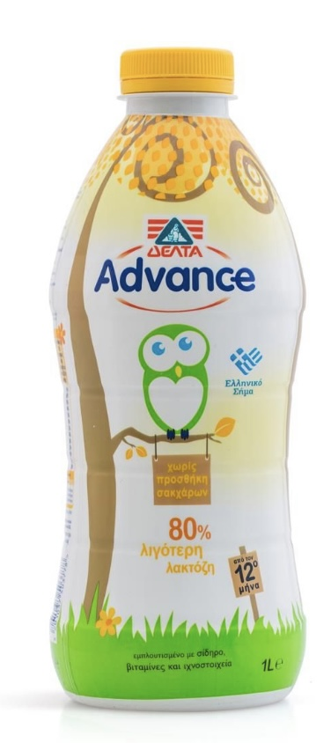
Branded Food Products targeted to children

Slide 30
In which food subcategories can we find them?
Food_SubCategory | Frequency | Percent
Milk | 15 | 11.5
Yogurt | 19 | 14.6
Cheese | 2 | 1.5
Pasta or similar Product | 2 | 1.5
Breakfast Cereal | 25 | 19.2
Fine Bakery Ware | 3 | 2.3
Starchy Root or Potato | 1 | 0.8
Chocolate | 22 | 16.9
Juice or Nectar | 13 | 10
Non-Alcoholic Beverage | 5 | 3.8
Prepared Food Product | 23 | 17.7
Total | 130 | 100

Slide 31
Prevalence of Health Claims per food subcategory that includes products targeted to children
Branded foods targeted to children (n=130) | N | (%)
Health Claims | 26 | 20

Slide 32
Prevalence of Nutrition Claims per food subcategory that includes products targeted to children
Branded foods targeted to children (n=130) | N | (%)
Nutrition Claims | 52 | 40

Slide 33
Products targeted to children and Nutri-Score
NC (n=51)
HC (n=26)
total (n=109)
NC: Products that carry Nutrition Claims
NC (n=51)
HC: Products that carry Healt Claims
HC (n=26)
total (n=109)
NC (n=51)
HC (n=26)
total (n=109)
NC (n=51)
HC (n=26)
total (n=109)
NC (n=51)
total (n=109)

Slide 34
ΑGRICULTURAL UNIVERSITY OF ATHENS
DEPARTMENT OF FOOD SCIENCE & HUMAN NUTRITION
Acknowledgements
Dr Antonis Vlassopoulos
Alexandra Katidi, PhD (c)
Stephania Xanthopoulou, PhD ©
The numerous students from the HelTH team

