Slide 1

Χρηματοοικονομική Ανάλυση κ΄ Λογιστική(Financial Analysis & Accounting)

Slide 2
Course Goals
This is a course on Financial Accounting & Reporting, Corporate Finance (Capital Budgeting) and Business Valuation (time permitting).
The aim of the module is to offer a detailed overview of basic level financial accounting and reporting examining disclosures to users of financial information of:
- operating results;
- financial position and cash flows of a business entity
and utilise this for investment decisions (financial statement analysis, capital budgeting and business valuation).
Emphasis is thus put on information that is relevant in making investment, credit and valuation decisions.
A user’s perspective, rather than a preparer’s is adopted with the students’ attention directed towards thinking on the quality of earnings, and not just the reported numbers.

Slide 3
Core objectives
Provide students with an understanding of:
The information content in the financial statements and the effects of economic events on them;
The framework for making business decisions using information in financial statements;
  what choices can be made, what the options are, how can related data be used for various types of investment decisions.
Upon completion of the course, students will be able to:
Understand the “language” of business, its uses and limitations;
Interpret and understand the impact economic events have on the Balance Sheet, Income Statement, Statement of Changes in Equity and Statement of Cash Flows;
Use the information reported in Financial Statements for financial analysis and investment decisions.

Slide 4
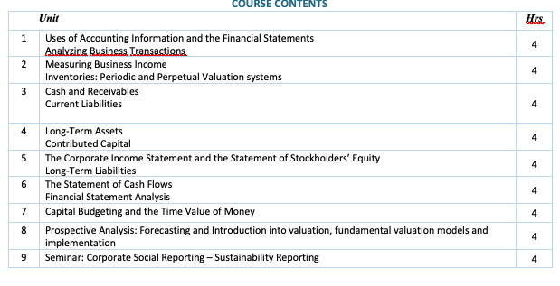
Course content

Slide 5
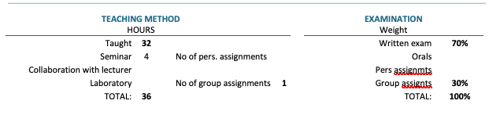
Teaching and examination

Slide 6
Bibliography
Atrill P., McLaney E. Accounting & Finance for non- specialists. Pearson education (English pdf)
Damodaran A. 2014. Εφαρμοσμένη Χρηματοοικονομική για Επιχειρήσεις. (επιμ) Ε. Τσιριτάκης, Τ. Αγγελίδης, Α. Ζαπράνης. Nicosia, Cyprus: Broken Hill, Αθήνα: Εκδόσεις Πασχαλίδης.
Datar Srikant M. & Rajan Madhav V. 2019. Horngren's Λογιστική Κόστους - Διοικητική Προσσέγγιση. Επιμέλεια: Σώρρος Ι., Παπαναστασόπουλος Γ., Γεωργακόπουλος Γ., Μανδήλας Α. Broken Hill Publications. Αθήνα: Εκδόσεις Πασχαλίδης.
Needles, B., Powers, M. and Crosson, S. 2016. Εισαγωγή στη Λογιστική. (επιμ.) Βενιέρης Γ., Ζήσης Β., Λοής Π., Σπαθής Χ., Σώρρος Ι., Τζελέπης Δ. Nicosia, Cyprus: Broken Hill, Αθήνα: Εκδόσεις Πασχαλίδης.
Nobles T. M., Mattison B. and Matsumura E. M (in Greek). 2024. Horngren's Χρηματοοικονομική Λογιστική. 6η Αγγλικη έκδοση (1η βελτιωμένη ελληνική έκδοση). Editors: Ginoglou D., Koumanakos E., Belesis N., Naoum V., Sorros I., Asonitou S., Georgakopoulos G., Boskou G., Pazarskis M., Tountas K. . Broken Hill Publications. Athens: Paschalidis.
Ross S., Westerfield W. R. 2016. Χρηματοοικονομική των Επιχειρήσεων. (επιμ.) Αγγελίδης Τ., Αρτίκης Π, Ελευθεριάδης Ι, Κοσμίδου Κ., Τσιριτάκης Ε, Φλώρος Χ. Nicosia, Cyprus: Broken Hill, Αθήνα: Εκδόσεις Πασχαλίδης.

